Slide 1

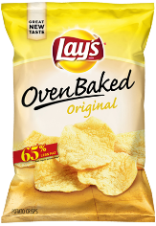


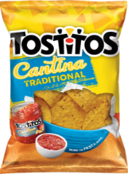
PepsiCo - Frito Lay Attrition Analysis and Recommendations
Douglas Yip
November 27, 2021
GitHUB - https://github.com/dk28yip/6306_EDACase2.git
Rshiny - https://dk28yip.shinyapps.io/6306_SMU_EDA2_Yip/
Youtube - https://youtu.be/RNLvVonVI6k

Slide 2

Agenda
Objectives
Provide Frito Lay Talent Management Team an iterative process with developing and retaining employees.
Discussion
Agenda
Attrition Deep dive analysis
Impact of Wage and Tenure
Work Life Balance and Travel
Associate working overtime
Job roles impacting attrition rate
4 Predictors that will help you improve your wage and attrition at Frito Lay
Action
Re-evaluate the Travel Program for frequently traveling associates
Re-evaluate your Overtime policies to ensure equitable working conditions and wage
Re-evaluate job description and wage requirements for low band levels like sales associates and research scientist

Slide 3
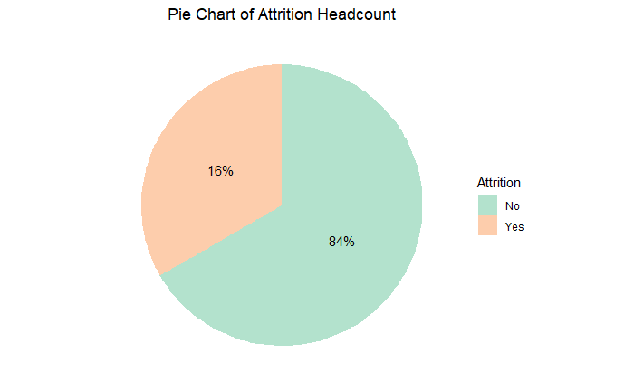
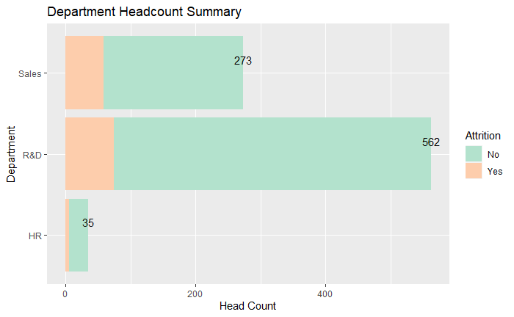
Acquired Frito Lay data is imbalanced; however, we have methods to identify solutions to reduce your attrition rate
Total Attrition
Attrition by Headcount
Summary of Data Set
Given that Frito-Lay is a Fortune 500 Consumer Packages Good company, we observe an unbalance dataset, where we have 16% of the associates identify as leaving the company, which we deem unreasonable and unlikely.
Headcount mainly pertains to R&D (562) and Sales (273) count.
There is enough detail in data to identify potential solutions to reducing you attrition rate

Slide 4
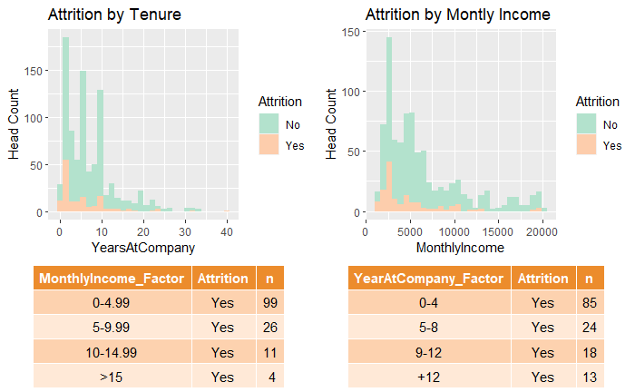
Majority of your Attrition occurs given Monthly incomes levels <$10,000 and tenure <12 years
Impact of Tenure and Monthly Income to Attrition
Attrition by Tenure and Monthly Income
A right skewed distribution is observed for attrition given tenure and salary.
<$10,000
Income Range where attrition occurred the most
<12 Years
Tenure Range where attrition occurred the most
Attrition analysis will exclude headcount outside the Income and Tenure Ranges

Slide 5

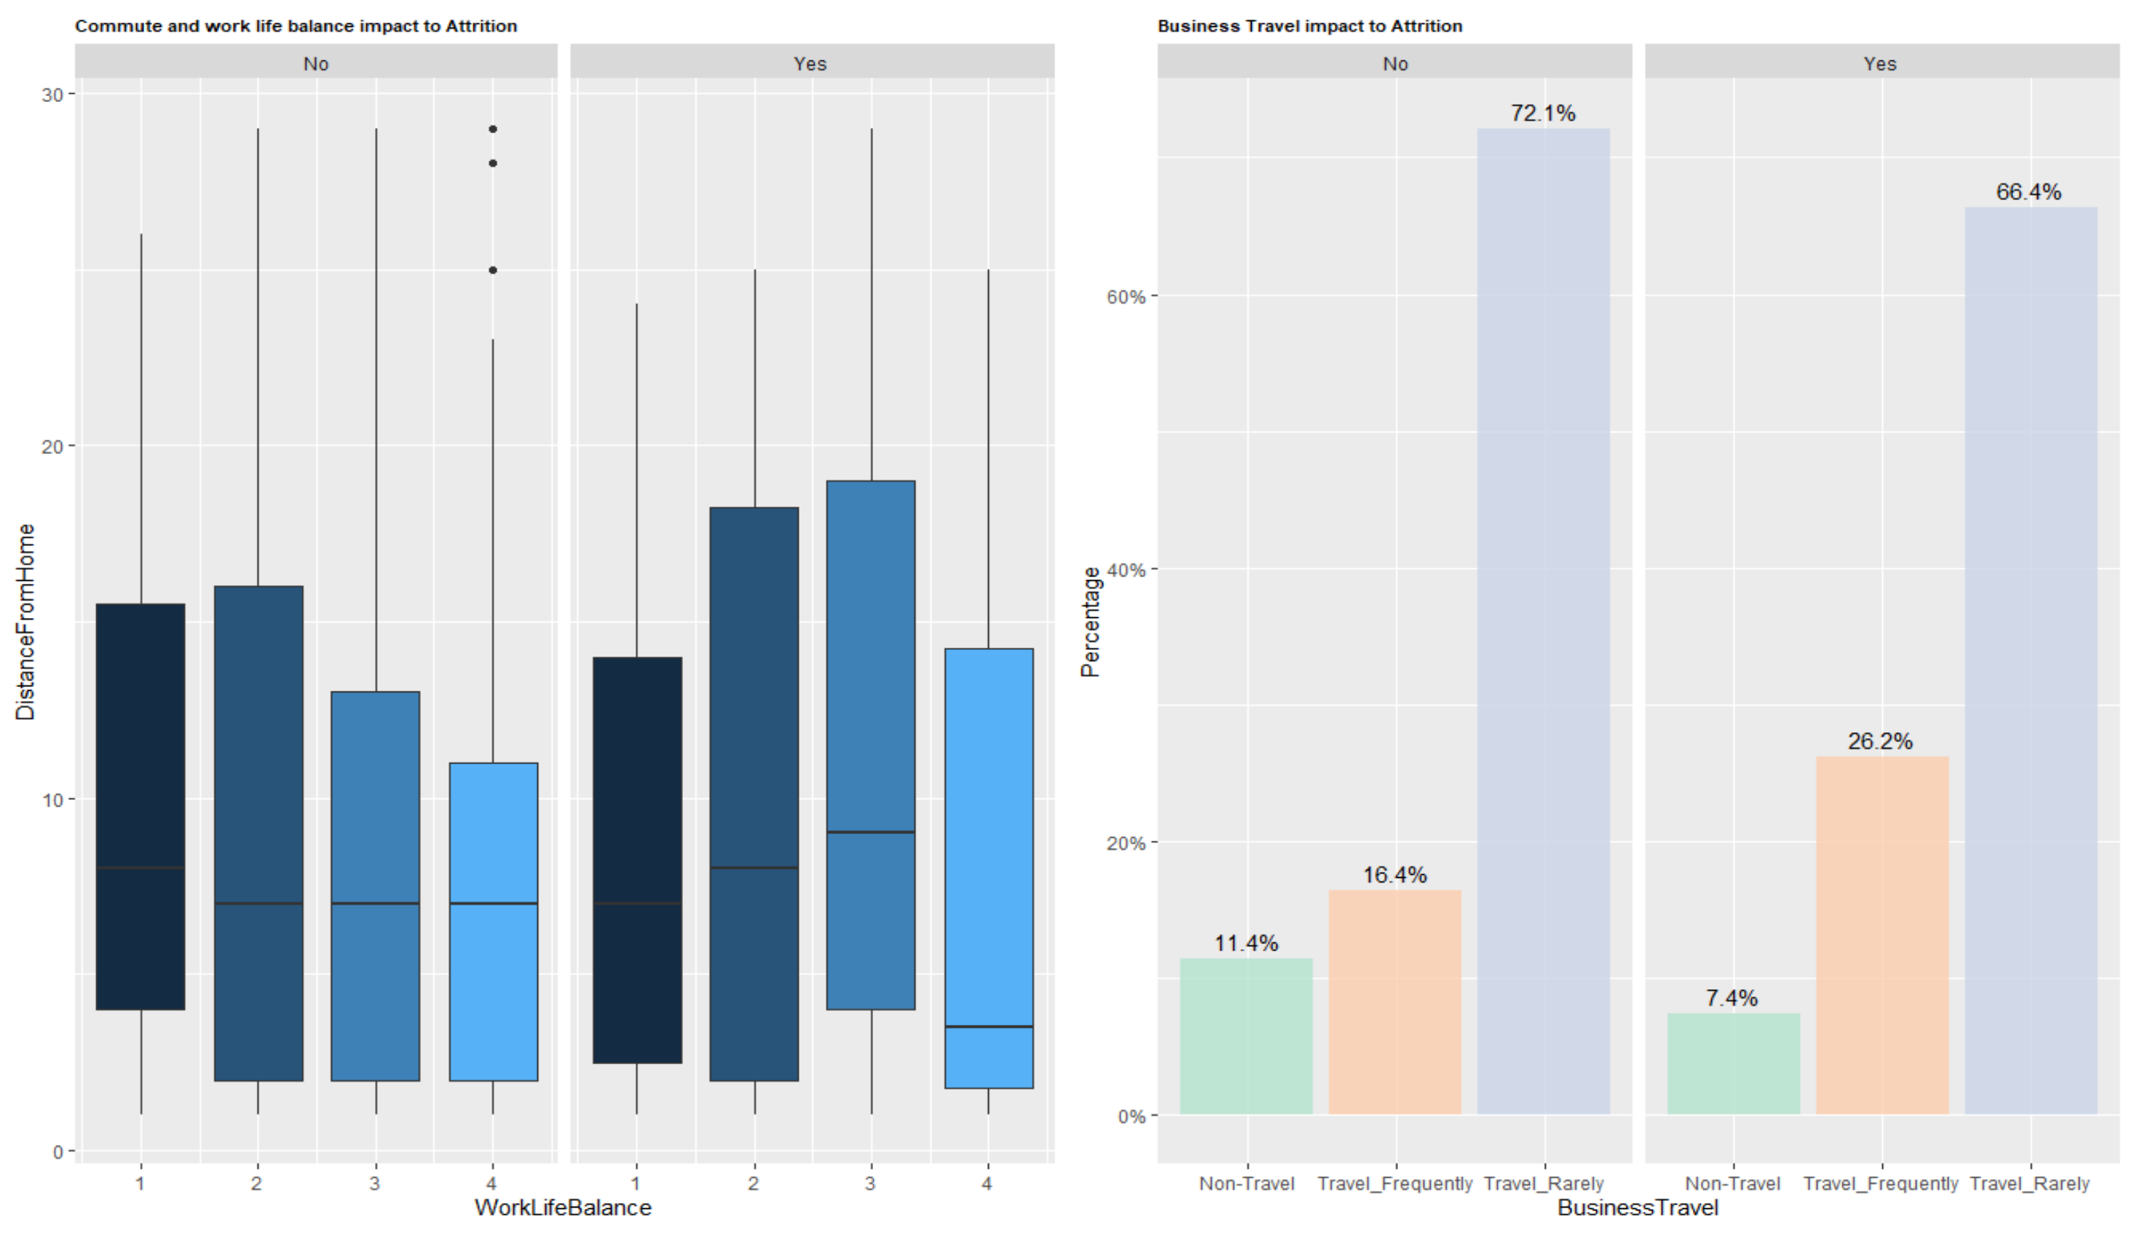
Commute and Work Life Balance (WLB) are inconclusive; however, we recommend to reevaluate you travel program to reduce your attrition rate
WLB impact on attrition is inconclusive
Travel program needs to be reevaluated
Work Life Balance Impact to Attrition
Increase commute more dissatisfied to WLB
Attrition over indexing for associates traveling frequently
1
We observed attrition trend where dissatisfaction is related to higher commute medians, but WLB is inconclusive as individuals who rated WLB the worse had the lowest median commutes and left the company. This associates left for other reasons.
Attrition on associates that travel frequently over index vs the rest and shows higher degree of leaving the company
Recommendation – We recommend that you review your travel program and compare it to industry to reduce your attrition rate.
2
1
2
Note: Assumes 1 Best and 4 Worse

Slide 6

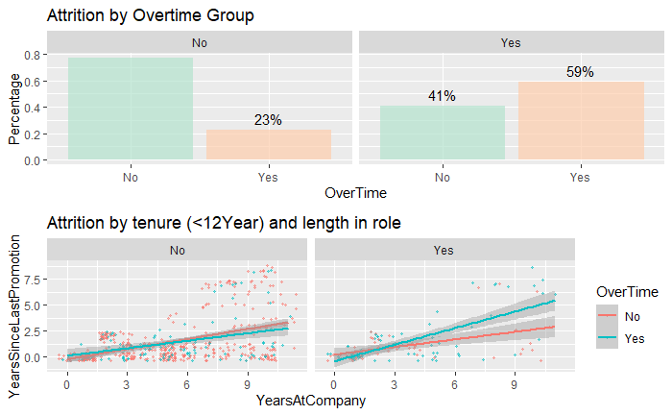
Associates who incur overtime are likely to leave the company
Associates who incur overtime impact attrition
Overtime Impact to Attrition
1
Attrition for associates who incur overtime significantly over indexes vs individual who do not.
Trends for associates who continue to work overtime over a long period time, have a higher chance with leaving
Recommendation – We recommend that you reevaluate your overtime program to ensure equitable working conditions and wages by looking any issues like forced overtime, caps to overtime and base wage.
1
2
2

Slide 7

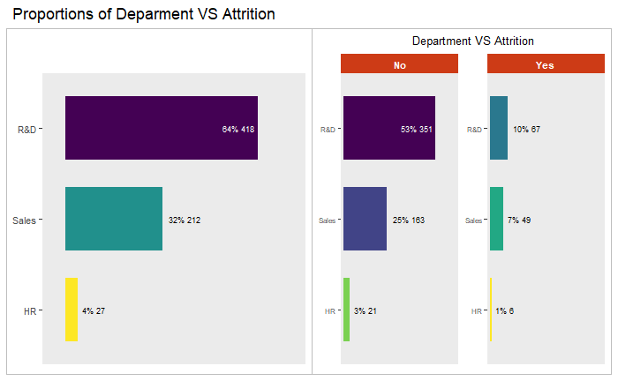
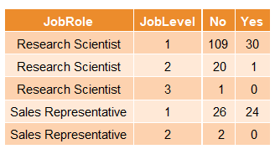
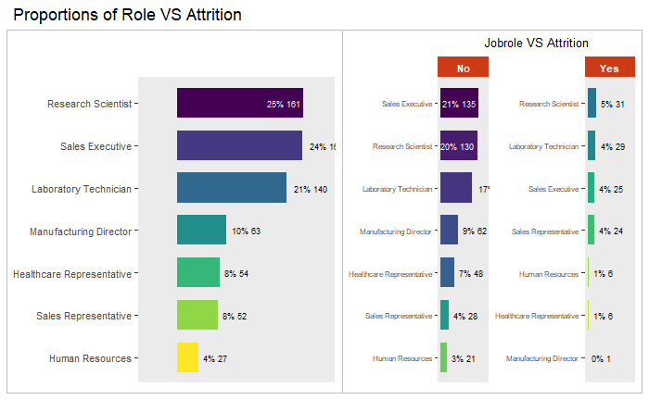
Research Scientist and Sales Reps with the lowest bands over index in attrition vs other roles. Comp&Ben team needs to evaluate job description and pay.
The Band and ype of role impact Attrition
Job and Level Impact to Attrition
High Research Scientist attrition where 31 of the 161 associates have left the company. Majority are low band employees.
High Sales Rep attrition where 24 of the 52 associates have left the company. All are low band employees.
Recommendation – We recommend that your Comp and Ben to re-evaluate the job description and pay within this group to ensure that jobs are equitable vs industry.
1
2
1
Roles by level with the highest attrition count
2

Slide 8
We are confident that 4 predictors can identify your attrition opportunities and wage inequalities
Why these predictors work
Predictors
Prediction Model for Attrition
We evaluated two models (KNN and Naïve Bayes) and identified the Naïve Bayes resulted in the best prediction
Accuracy – 84%
Sensitivity – 92%
Specificity – 49%
Predict Wage through Linear Regression Utilizing Overtime status, Job Band, Tenure and Monthly income, the linear regression predicted your associates' wages and yielded a RMSE error of $1401. Lower than your target of $3000.
Attrition Status
Monthly Income
Overtime Status
Response Variable for MLR
Job Band
Tenure

Slide 9
Key Takeaways Three Actions to take to improve your attrition
Travel Program
Overtime
Job Description/Wage
Issue
Associates who travel-frequently over index in attrition vs others that do not travel
Action
Re-evaluate your travel program. Create a survey to identify how often is the travel, how long are the trips and incentives vs industry?
Issue
Associates who work over time and for long periods off time over index in attrition vs associates who do not work overtime
Action
Re-evaluate your overtime policies to ensure equitable working conditions and wage. Investigate into potentials issues like forced overtime, reasons why people work overtime, and comparison vs industry
Issue
Associates with low job bands likes, sales associates and research scientist, over index in attrition vs other roles
Action
Have your Comp and Ben team to re-evaluate the job description and median wages of these low band roles vs industry.

Slide 10
Thank You!!
Any questions
or concerns?

Slide 11
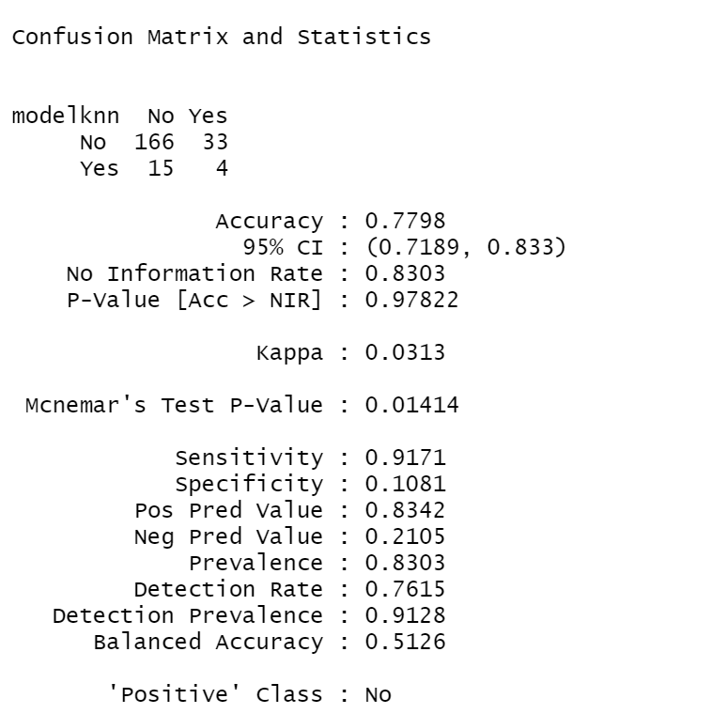
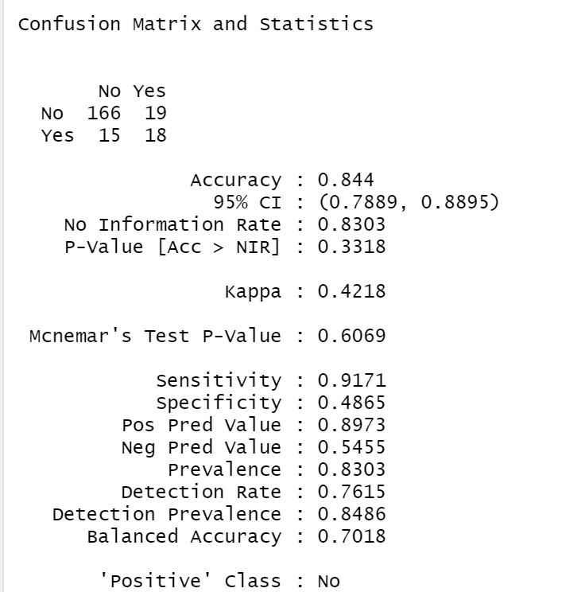
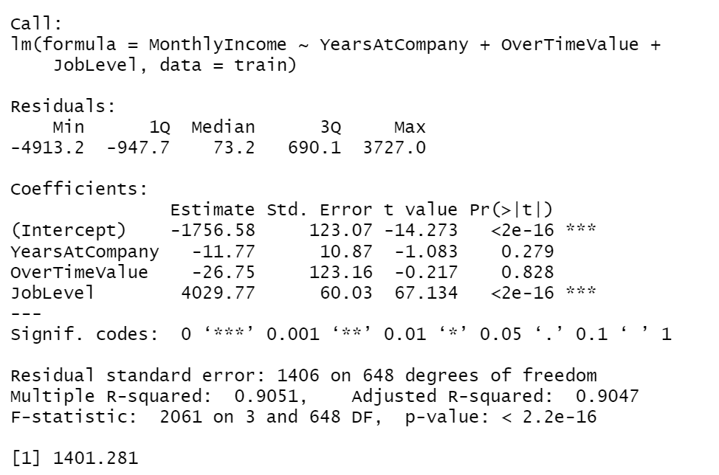
Appendix – Model Output
KNN - Attrition
Naïve Bayes - Attrition
MLR - Wage
RMSE

